Slide 1
Lincoln on Leadership

Slide 2
He Was a Man with a Checkered Past
Fellow citizens, we cannot escape our history.

Slide 3
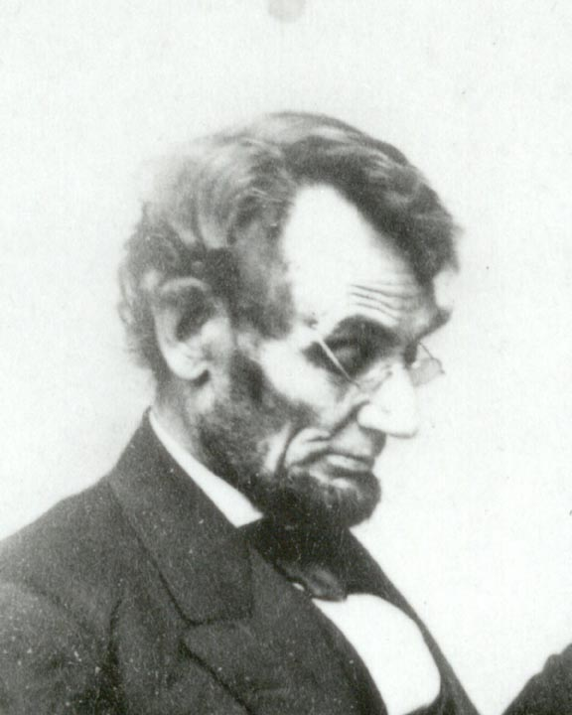
His failures and losses were many. In business…
1831: His first business failed.
1832: He lost his job after losing the election for state legislator.
1832: He was denied admission to law school.
1833: He borrowed money to start a business and went bankrupt in a year.

Slide 4
And in Politics
1834: He was elected to the state legislature by slimmest margin.
1836: He suffered a nervous breakdown and spent six months in bed recovering.

Slide 5
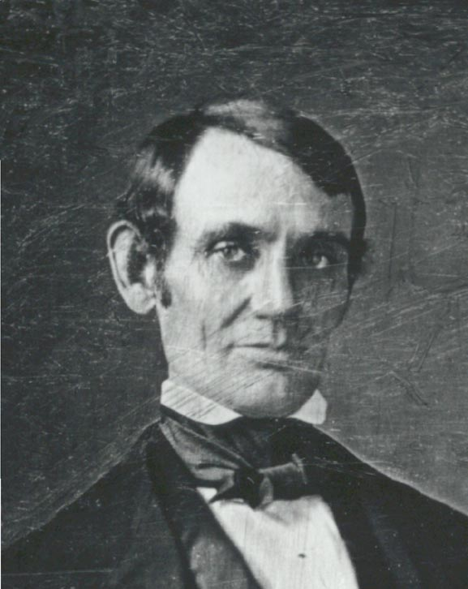
He lost…
1838: He ran for speaker of the state legislature and was defeated.
1840: He ran for elector and was defeated.

Slide 6
Again
1843: He ran for Congress and lost; he won in 1845.
1848: He lost his re-election race for Congress.
1849: He was rejected as land officer in his hometown.

Slide 7
And Again
1854: He ran for the U.S. Senate and lost.
1856: He sought the vice-presidential nomination and lost.
1858: He ran again for the U.S. Senate and lost.

Slide 8
On balance, he could easily be a seen as a loser.
The sum of his losses was great.
The number of victories was small.
In fact, there were really only three.

Slide 9
But what victories they were!

Slide 10
He preserved the Union.
Despite a terrible price, the Union endured.

Slide 11
He changed the course of the nation and the world.
With the Emancipation Proclamation
he set millions of people in bondage on the long, hard road to freedom.

Slide 12
He turned a continent into a nation.
He ordered construction of the trans-continental railroad…
and united the nation east to west.

Slide 13
The Final Score
If we just tallied his wins and losses,
he would be remembered as a loser.
Or not remembered at all.

Slide 14
A National Hero
But because of the size of his victories…
He inspires anyone who would leave the world a better place than they found it.

Slide 15
He provides lessons for all leaders, even in our own challenging century

Slide 16
Lesson 1: Never Give Up
Your own resolution to succeed is more important than any other.
Hold on with a bulldog grip, and chew and choke as much as possible.
My great concern is not whether you have failed, but whether you are content with your failure.

Slide 17
Lesson 2: On Friends and Foes
I destroy my enemies when I make them my friends.
I don't like that man. I must get to know him better.
If you look for the bad in people expecting to find it, you surely will.
No matter how much cats fight, there always seem to be plenty of kittens.

Slide 18
More on Friends and Foes
A friend is one who has the same enemies as you have.
Keep your friends close…
And your enemies closer.

Slide 19
Lesson 3: About Character
Character is like a tree and reputation like a shadow.
The shadow is what we think of it; the tree is the real thing.

Slide 20
More on Character
I don't know who my grandfather was…
I am much more concerned to know what his grandson will be.

Slide 21
And More on Character
Nearly all men can stand adversity, but if you want to test a man's character, give him power.
No man has a good enough memory to be a successful liar.

Slide 22
Lesson 4: How to Treat Others
No man is good enough to govern another man without that other's consent.
We should be too big to take offense and too noble to give it.

Slide 23
How to Treat Others
If there is anything that a man can do well, I say let him do it. Give him a chance.
Tact is the ability to describe others as they see themselves.

Slide 24
Lesson 5: On Education
The philosophy of the school room in one generation…
…will be the philosophy of government in the next.

Slide 25
On Education
Things may come to those who wait, but only the things left by those who hustle.
Towering genius disdains a beaten path. It seeks regions unexplored.

Slide 26
More On Education
We can complain that rose bushes have thorns,
or we can rejoice that thorn bushes have roses.
Whatever you are, be a good one.

Slide 27
Lesson 6: Go Slow to Go Fast
Give me eight hours to chop down a tree
and I will spend the first six sharpening the axe.

Slide 28
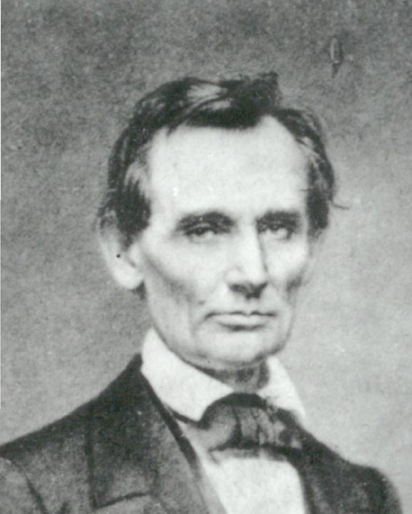
Go Slow to Go Fast
I walk slowly, but I never walk backward.
The best thing about the future is that it comes one day at a time.

Slide 29
Lesson 7: Practice Humility
What kills a skunk is the publicity it gives itself.
Avoid popularity if you would have peace.

Slide 30
Humility
It is better to remain silent and be thought a fool…
than to open one's mouth and remove all doubt

Slide 31
Humility
He can compress the most words into the smallest Idea of any man I ever met.
If I were two-faced, would I be wearing this one?
It has been my experience that folks who have no vices have very few virtues.

Slide 32
Humility
When you have got an elephant by the hind legs,
and he is trying to run away,
it's best to let him run.

Slide 33
Lesson 8: Pursue Justice
Whenever I hear anyone arguing for slavery,
I feel a strong impulse to see it tried on him personally.

Slide 34
Pursue Justice
Those who deny freedom to others deserve it not for themselves.
To stand in silence when they should be protesting makes cowards out of men.
.

Slide 35
Lesson 9: Understand Your Legacy
In times like these, men should utter nothing for which they would not be responsible through eternity.

Slide 36
On Legacy
America will never be destroyed from the outside.
If we falter and lose our freedoms,
it will be because we destroyed ourselves.

Slide 37
On Legacy
I am a firm believer in the people.
If given the truth, they can be depended upon to meet any national crisis.
The great point is to bring them the real facts.

Slide 38
On Legacy When I do good, I feel good. When I do bad, I feel bad. That is my religion.

Slide 39
On Legacy
I want it said of me
that I always plucked a thistle
and planted a flower where I thought a flower would grow.

Slide 40
Our Legacy
My dream is of a place and a time
where America will once again be seen
as the last best hope of earth.

Slide 41
Now He Belongs to the Ages

