Slide 1
The Design Process
Strand 3 – Part 2

Slide 2

Standard
Students will understand the basics of the design process.
  Standard 1: Identify the steps in the design process

Slide 3
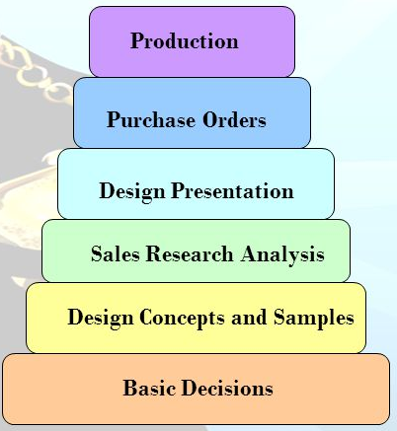
6 Steps of the Design Process
1. Basic Decisions
2. Design Concept & Samples
3. Sales Research Analysis
4. Design Presentation
5. Purchase Orders
6. Production

Slide 4
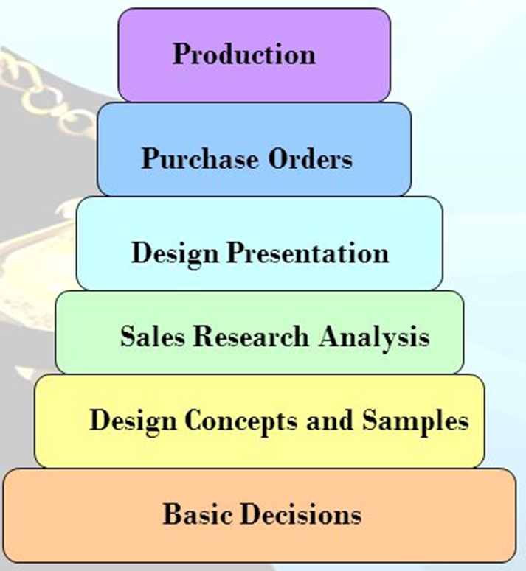
Step 1. Basic Decisions
Many decisions are made before the designing process, they can include:
  Fabric Choice
  Design Ideas
  Number of items to be sold
  Type of promotion

Slide 5

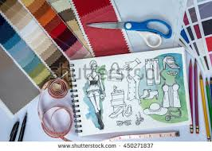
Step 2. Design Concepts & Samples
Next the designer develops the concept & appearance of the fashion.
  Sketches & Diagrams are prepared
      Include fabric & color choices
  Patterns & samples are produced

Slide 6
Step 3. Sales Research Analysis
The Sales department plays a key role at this point.
  Records have been kept to show the history of styles that were previously offered.
      Including price & quantity
  This information helps to determine what & how much will be produced.

Slide 7
Step 4. Design Presentation
Now the collection is ready to be shown
  Some designers participate in elaborate fashion weeks.
  Others have their merchandise available for preview in the showrooms.

Slide 8
Step 5. Purchase Orders
Retail buyers begin purchasing merchandise that has been presented.
Some styles may be eliminated.

Slide 9
Step 6. PRoduction
Now that orders have been placed production begins.
Final samples and fittings take place.
Then final patterns are made and sewing starts.

Slide 10
Terms to know
Patternmaking
    the process of transforming the design into the appropriate pieces needed to produce an apparel item.
Grading
    the technical process of increasing or decreasing the sizes of a pattern to correspond to a garment size.
Samples
    After a pattern is made, samples are made to a “model” fit size of 6, 8 or 10. Live models wear the samples, and the staff can make any final alterations and corrections before the garments are shown to retail buyers.

