Slide 2
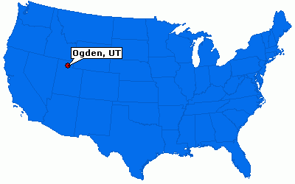
Introduction
Clothing company which sells petite clothes for women ages 16-30
Brick and Mortar and Click and Mortar
No direct competition
Located in Ogden, UT

Slide 3
Problem
Clothes do not fit
Too Expensive
Small selection

Slide 4
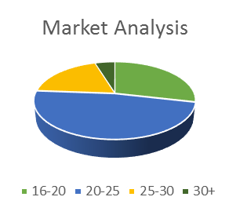
Customer Segments
Demographics
- Women
- Ages 16-30
- Under 5’4 in height
Psychographic
-All social classes
Behavioral
- Women who want to feel confident and comfortable in their outfits

Slide 5
Unique Value Proposition
Similar in size to common clothing retailers
H&M and Justice (i.e. store size)
Unique for petite sizes in age appropriate designs and styles
Huge variety of prices, departments, styles, and patterns
Offers Custom Smallz
No direct competition

Slide 6
Solutions
Wide variety of sizes so the clothes will fit properly
Full range of prices to make the clothes more affordable
Several departments to give customers endless options of clothes

Slide 7
Channels
SMALLZ Designers
Manufacturers
Stores
Customers

Slide 8
Revenue
Advertising
- Social Media
- Radio
- Billboards
- Apps
Licensing
- Smallz will license the measurements, designs, and styles of their clothing. There will also be a copyright of the name of the business

Slide 9
Lifetime Values
Estimated Customer Lifetime Value: $139.98

Slide 10
Financial Plan 1 Year Income & Expenses

Slide 11
Financial Plan 5 Year Income, Growth & Expenses

Slide 12
Key Metrics
Actual Sales
Licensing/ Patents
Total Expenses
Estimates Sales Revenue
Start-up Costs
Target Market

Slide 13
Competitive Advantage
Only store to offer exclusively petite adult styles and designs.
Smallz will also have an entire store of petite size clothing, while many stores only have as much as one rack in their entire store for petite women.
Licensing
Business Security

Slide 14
Overview
Petite size clothes
Age Appropriate styles
Affordable
Variety of Departments
We are asking for a $300,000 loan for 30% in the company

