Slide 2
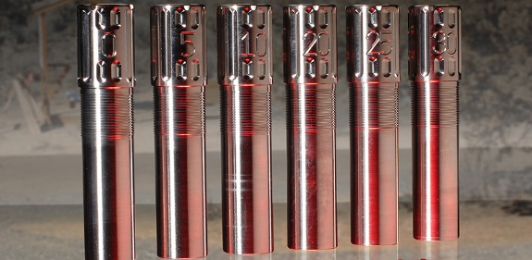
Introduction
QuickChoke will allow any trap shooter to insert a gun choke in 30 seconds or less!
The choke will consist of 12 threads making the inserting of the choke fast and secure on to the shotgun
This choke will have a very slight weight at the end of the barrel to keep the gun at a vertical angle.

Slide 3





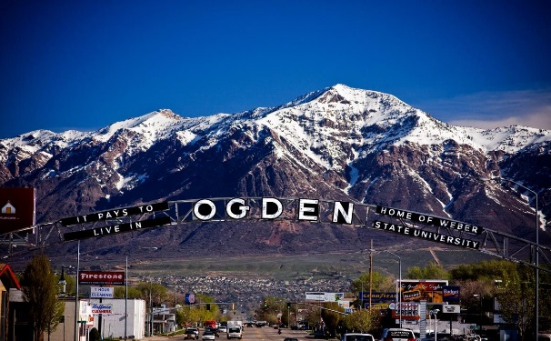

Business Situation
My business will be manufactured in Ogden, Utah.
All major outfitter stores:
This choke will also be able to be purchased on

Slide 4

Opportunities
QuickChoke will be on social media. This will open up our target market allowing shooters to see what is available on the market.
Eventually QuickChoke will have intentions of partnering with The Browning Outlet.

Slide 5
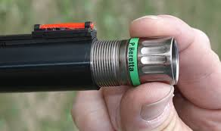
Differentiation
No other product like it on the market.
Quick
Saves money
Color coated

Slide 6

Financial Needs
Loan of $90,000.00 with 7% interest.
Will be paid over 8 years.
Choke will cost $45.00-85.00

Slide 7
Overview
Time saving
Money saving
Loan of $90,000.00 with 7% interest.
Happy shooters

Slide 10
