Slide 3
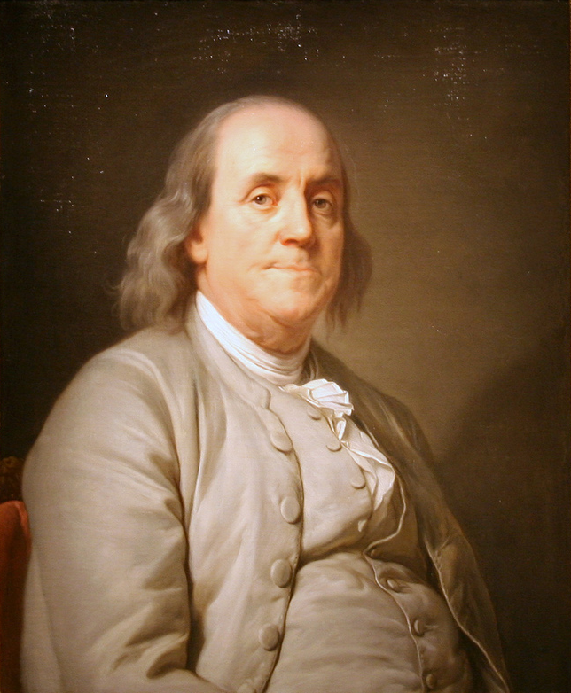
Lesson 6: Time & Meeting Management
“Dost thou love life? Then do not squander time for that is the stuff life is made of.”
-Benjamin Franklin

Slide 4
Carpe Diem-Seize the Day
TO THE VIRGINS, TO MAKE MUCH OF TIME by Robert Herrick
Gather ye rose-buds while ye may: Old Time is still a-flying; And this same flower that smiles
to-day, To-morrow will be dying. The glorious lamp of heaven,
the Sun, The higher he's a-getting, The sooner will his race be run, And nearer he's to setting. That age is best, which is the first, When youth and blood are warmer; But being spent, the worse, and worst Times, still succeed the former. --Then be not coy, but use your time, And while ye may, go marry; For having lost but once your prime, You may for ever tarry.

Slide 5
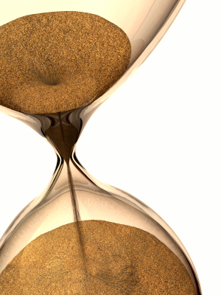
1. What is time management?
Time Management: Using the time available to the greatest advantage.
When you are in control of your time you perform better, feel better, and are less stressed
First thing to do is assess your present time management skills to see if you have symptoms of poor self management.
Indecisiveness? Procrastination? Always running late for appointments and events?

Slide 6
2. What are the two governing principles of time management?
First: “Who’s in charge?”
Are you in charge of the events in your life, or are they in charge of you?
You must be in control for effective time management.
Develop the attitude of taking charge and control over the things in your life.
Second: Developing self-mastery of discipline by developing good habits.
“We make our habits, then they make us.”
Acquiring good habits is an ongoing process of identifying and eliminating bad habits then replacing the habits.

Slide 7
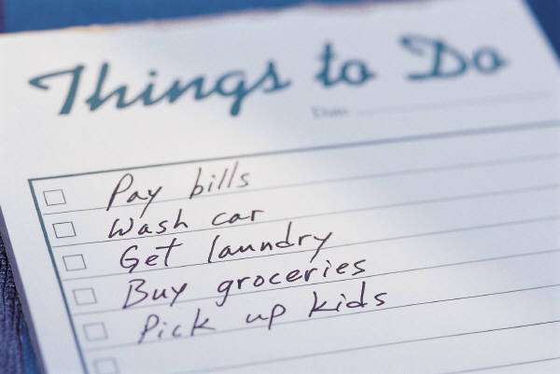
3. What are some effective time management guidelines?
Create a daily “To Do” list.
Traditional “ABC” list of prioritizing your tasks keeps track of jobs and details.
Develop effective delegation.
Follow up on tasks done by others.
Control & minimize interruptions.
Ask yourself if it is an emergency or not.
Handling phone calls.
Be sociable but don’t waste time. Stand up when important. Write down notes.

Slide 8
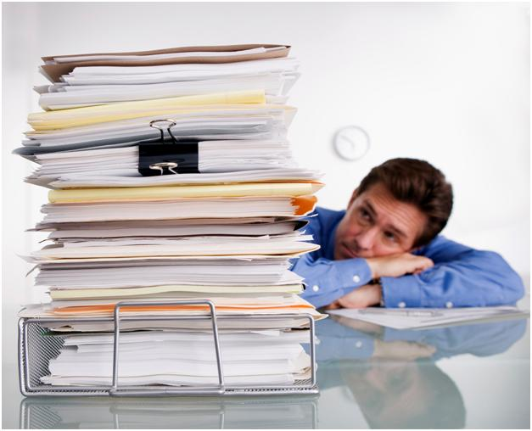
3. What are some effective time management guidelines?
Take action against procrastination!
If important, JUST DO IT!
Develop rules for handling paper work.
Handle paper work just one time.
Handle it NOW and be done with it.
Use clear and effective communication.
Prepare what you say ahead of time.
Avoid distracting places to talk.
Watch your “Open Door” policy.
Always be mindful of every conversation.
Daily planners ARE A MUST! (Physical reminders)

Slide 9
4. What are some effective meeting management tools?
For meetings to accomplish results, rules & procedures should be established.
Leader must act as the referee.
Define all issues and goals before the meeting.
Provide research by giving relevant data.
Prepare an agenda.
Keeps meeting on track.
Define limits: Time, authority, policies.

Slide 10
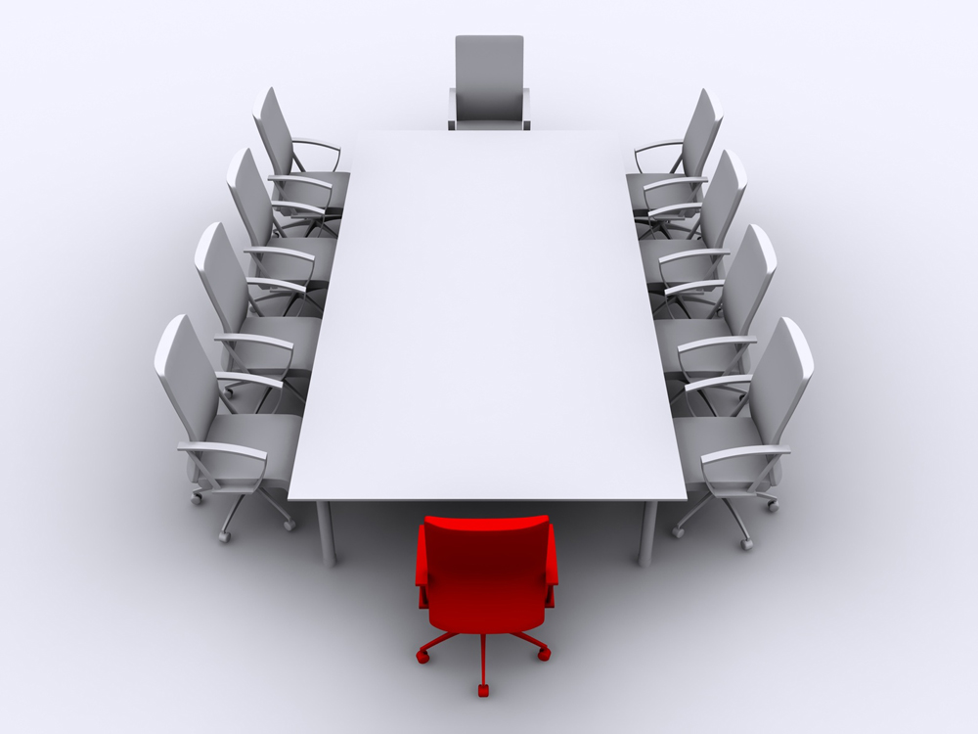
3. What are some effective time management guidelines?
Prepare the physical facilities (meeting venue). Plan for the unexpected.
Prepare the group members
Send out agenda if necessary.
Keep control over the meeting.
Deal with arguers, private talkers.
Try to involve all in attendance.
Keep records.

Slide 11
5. Why is delegation an important tool for effective time management?
Delegation: Entrusting an activity to another person.
Downward transfer of power.
Failure to delegate common reason for leadership failure.
Doing more delegation is needed if morale is down, leader is working late, confusion occurs, frequent questions, and deadlines are missed.
Main delegation benefits include freeing up a leaders time, improving worker’s capability, motivation, work distribution, and leadership preparation.
Certain tasks should not be delegated.

Slide 12
6.What is the five step process of delegation?
The “ICPME” Model of delegation consists of:
Identifying the task to be delegated
Choosing a right person
Preparing the person
Monitoring the progress
Evaluating the results.

Slide 13
ICPME Model
First step is to identify the task to be delegated.
Remember those tasks you shouldn’t delegate.
Hiring, firing, pay issues, policies.
Start off with simple and routine tasks.
Daily duties.
Least critical.
Dislike most.
Performed better by others.
“Where can I best spend my time?”

Slide 14
ICPME Model
The second step is to choose the right person.
Who is an appropriate person for the task?
Assessment of skills and capabilities.
Importance of knowing your people.
Motivational level and desire to learn.
Future leadership screening process.

Slide 15
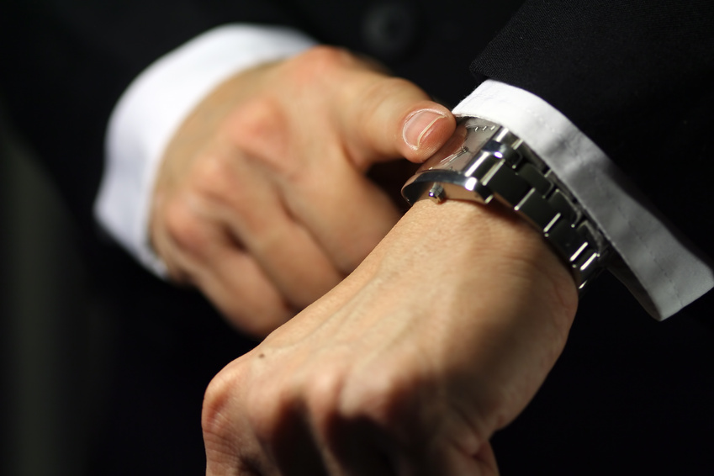
ICPME Model
Third step is to prepare the person.
Define the boundaries, expectations, expected results, deadlines, authority, and necessary training.
Write down key points.
Be willing to give up some power and control.
Provide necessary resources.

Slide 16
ICPME Model
The fourth step is to monitor the progress.
Allow for growth.
Encourage individuality.
Variety of methods.
Check up carefully without micromanaging.

Slide 17
ICPME Model
The fifth step is to evaluate results.
Evaluate results, not methods.
Remember expectations that were established.
Provide appropriate acknowledgement and recognition.
Keep written record for future use.
Mutually discuss process and experience.

Slide 18
ICPME Model
The leader is still ultimately responsible for the task to be accomplished.
Surround yourself with the best people you can find then delegate effectively.
The key: Recognize and train the right people.

Slide 19
Delegation Wisdom Tidbit #1
“Surround yourself with the best people you can find, delegate authority, and don’t interfere.”
-President Ronald Reagan

Slide 20
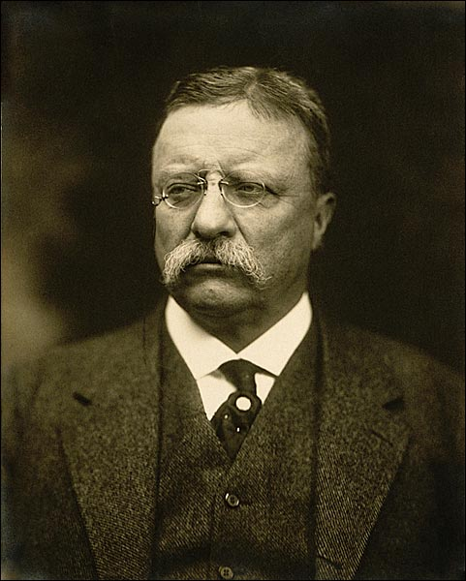
Delegation Wisdom Tidbit #2
“The best executive is the one who has sense enough to pick good men to do what he wants done, and self-restraint enough to keep from meddling with them while they do it.”
-President Theodore Roosevelt

Slide 21
The Bank Of Time
Imagine there is a bank that credits your account each morning with $86,400. It carries over no balance from day to day. Every evening it deletes whatever part of the balance you failed to use during the day.
What should you do?
Draw out every cent, of course!!!!
Each of us has such a bank. It's name is TIME.
Every morning, it credits you with 86,400 seconds. Every night it writes off, as lost, whatever part of this you have failed to invest to good purpose. It carries over no balance. It allows no overdraft. Each day it opens a new account for you. Each night it burns the remains of the day. If you fail to use the day's deposits, the loss is yours.
There is no going back.
There is no drawing against the "tomorrow". You must live in the present on today's deposits. Invest it so as to get from it the utmost in health, happiness, and success! The clock is running. Make the most of today. To realize the value of ONE YEAR, ask a student who failed a grade. To realize the value of ONE MONTH, ask a mother who gave birth to a premature baby. To realize the value of ONE WEEK, ask the editor of a weekly newspaper. To realize the value of ONE HOUR, ask the lovers who are waiting to meet. To realize the value of ONE MINUTE, ask a person who missed the train. To realize the value of ONE SECOND, ask a person who just avoided an accident. To realize the value of ONE MILLISECOND, ask the person who won a Silver Medal in the Olympics.
Treasure every moment that you have! And treasure it more because you shared it with someone special, special enough to spend your time. And remember that time waits for no one.
Yesterday is history,
Tomorrow is a mystery,
Today is a gift,
That's why it's called the present!!

Slide 22
Today in Leadership:
We will be doing Standard 6 – Time Management
Complete Std. 6 Notes, Assignments on 6-11, 6-12
Complete “Managing Your In Basket” worksheet
Quiz #6
If you get done with everything read your biography or work on your Book Report – info can be find on the class website: toripollard.weebly.com

