Slide 1
Page 5-7 How much Do you Know about Goal Setting --complete this activity first on page 5-7 in your book – then start your notes

Slide 2
212 degrees

Slide 3
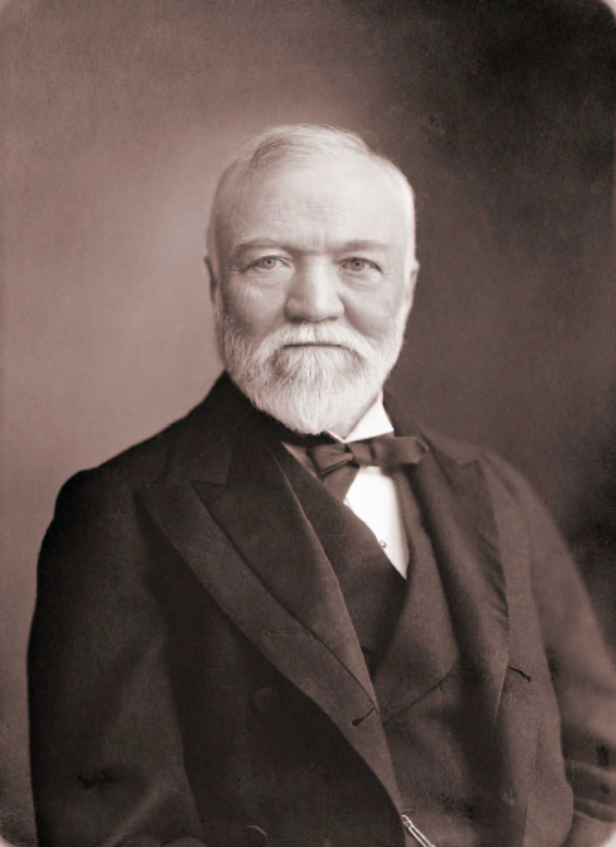
Lesson 5: Setting Goals
“If you want to be happy, set a goal that commands your thoughts, liberates your energy, and inspires your hopes.”
Andrew Carnegie
“A goal properly set is halfway reached.”
Abraham Lincoln
“Setting goals is the first step in turning the invisible into the visible.”
Anthony Robbins

Slide 5
1. What is a goal?
A goal is an objective, target, or result from the completion of tasks, activities, or programs.
Goals are necessary to promote growth.

Slide 6
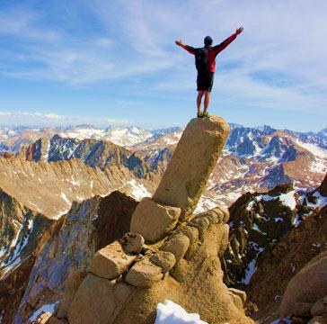
2. What are the three categories of goals?
Short-range goals usually deal with current activities.
- Applied on a daily basis
Intermediate goals: Built on foundation of short-range goals.
- deal with months and years.
Long-range goals
- Reflect the dreams, visions, and mission of the organization.

Slide 7
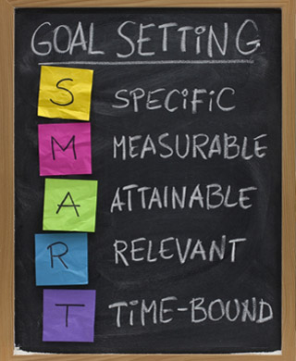
3. What are the basics of setting goals?
Five basic characteristics of goal setting.
- (Be “S.M.A.R.T.”)
Goals are only meaningful if Specific
- Write down EXACTLY what is to be done.
For accurate feedback, goals must be Measurable (this monitors the progress).
Ensure Accountability to individuals responsible for the task.
Goal be challenging but Realistic.
Make Timely deadlines toward achievement.
Specific
Measurable
Accountability
Realistic
Timely

Slide 8
4. How do you set goals?
Purpose: To monitor progress through periods of time.
First: Specify the general objective.
Second: Specify how to measure the performance. (units, time, money . . .)
Third: Specify the standard or target objective.

Slide 9
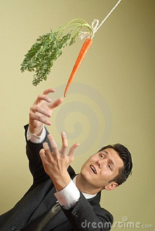
Setting goals continued
Fourth: Specify the time span involved.
- Deadlines must be put into place.
Fifth: Prioritize goals.
Sixth: Rate goals based on difficulty & importance.
Seventh: Determine coordination requirements.

Slide 10
5. How to obtain organizational goal commitment?
Goals alone cannot assure success . . . strategies and actions by leaders must be instigated.
First step: managerial support.
- commitment from leaders.
- provide supplies, time, resources.
Employee participation.
- Managers must seek input.

Slide 11
obtain organizational goal commitment continued
Knowledge of organizational capabilities.
- different talents among employees.
- match goal difficulty with capabilities of group or individual.
Strategic use of rewards.
- connect reward with accomplishment.

Slide 13
Oh The Places You’ll Go…..
https://docs.google.com/file/d/0B3vWOF65zaP1eXVfQkk3dHExUFE/edit?pli=1

Slide 14
Case 5 - Dismissal
Turn to page 5-6 in your book and complete Case 5: Dismissal

Slide 15
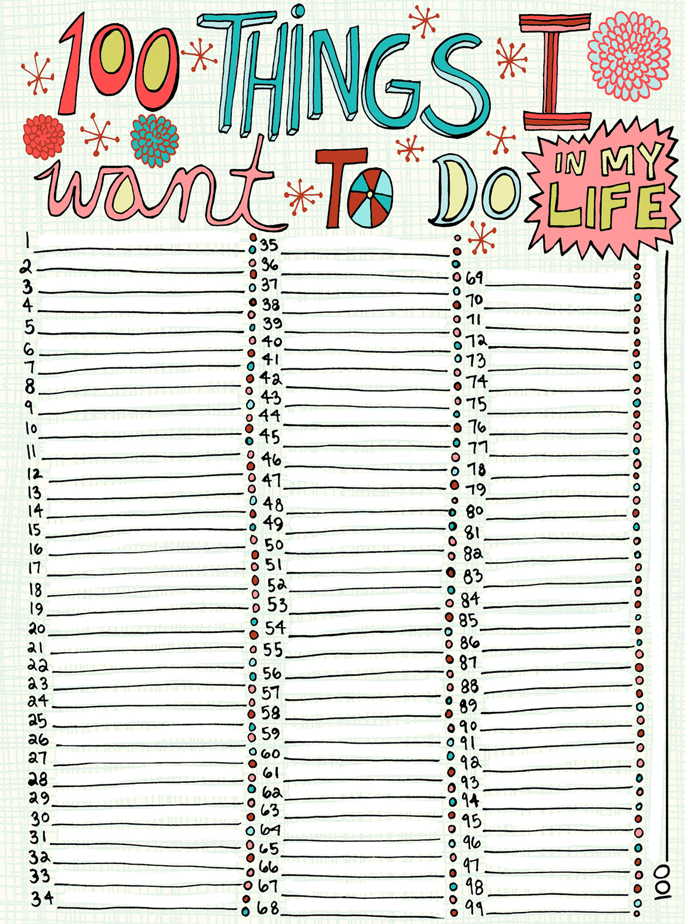
100 Things I want to do in my life – okay so if you don’t get to 100 that’s okay. List as many as you can think of
Fill in this worksheet with 100 things you want to accomplish or do in your lifetime

Slide 16
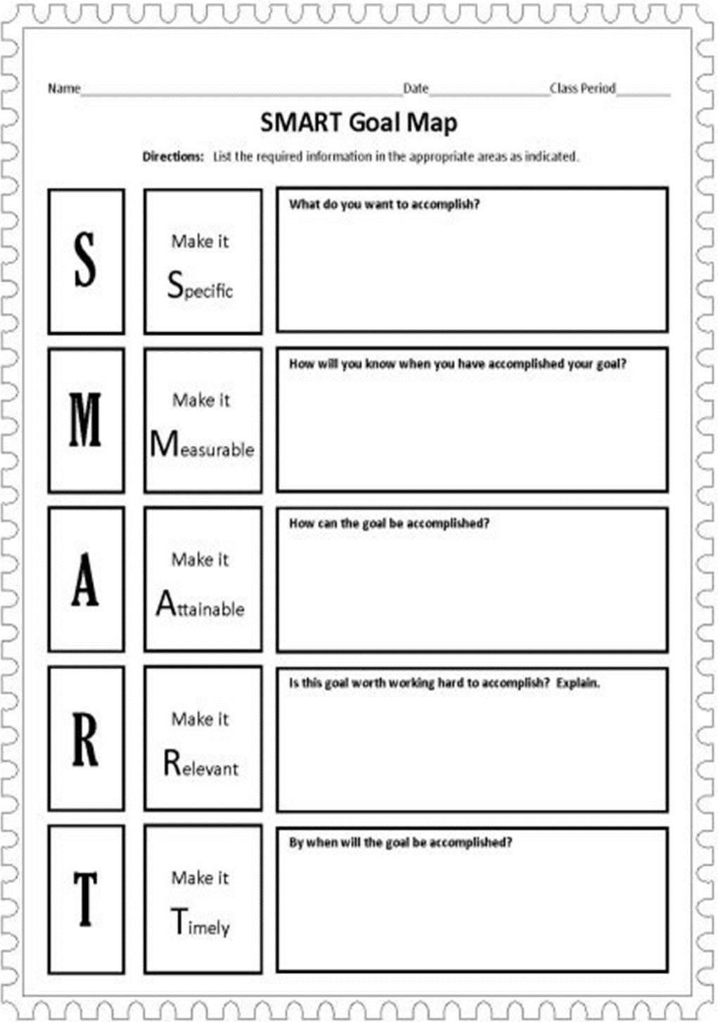
Smart Goal Map
Now complete the worksheet “Smart Goal Map”

Slide 17
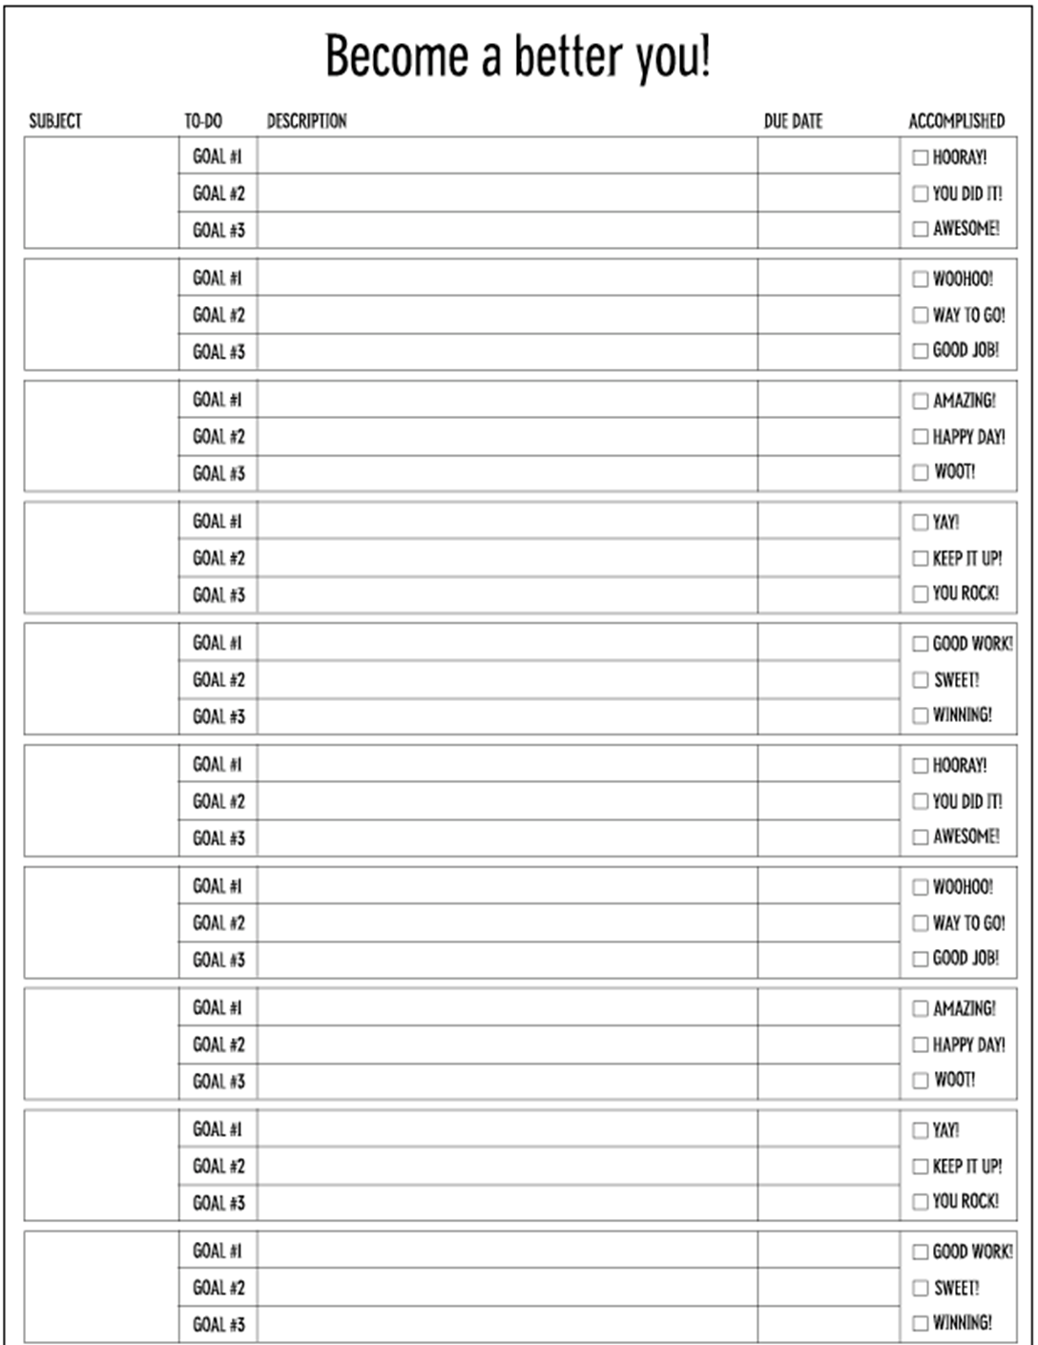
Be A Better You
Complete the worksheet “Be a Better You” there is an example of completed one on the next slide

Slide 19
Complete the Letter to yourself. You will keep it in the envelope given to you. You won’t turn it in.

Slide 20
Your Goals for 2018

Slide 21
Journal entry
Lesson 5 is about setting goals, how does the 212 Degrees video relate to this topic?

Slide 22
In your BOok
Complete: Case 5: Dismissal on page 5-6
Complete: How much do you know about Goal Setting on page 5-7

Slide 23
Quiz #5
Now complete Quiz #5

Slide 24
You will be handing the following things in on Friday before you leave class:
Remember to get your Biography Book read. When you return from Fall Break we will start working on our Biography reports/presentations.

Slide 25
Read your biography
Read your biography.

