Slide 1
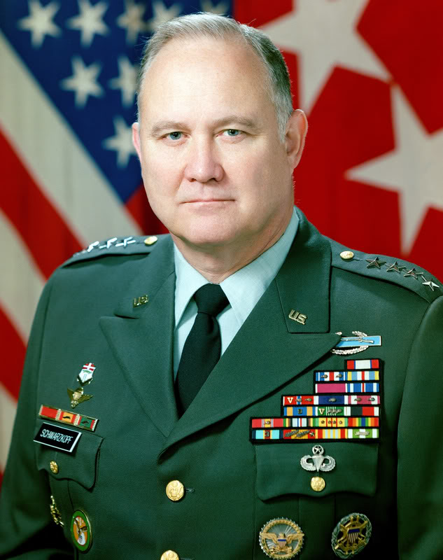
Lesson 3: Developing Your Personal Leadership Style
“Leadership is a combination of strategy and character. If you must be without one, be without the strategy.”
-Gen. Norman Schwarzkopf

Slide 2
1. What is a leadership style?
For many years leadership has been thought of as a combination of personality traits.
A leadership style is a particular pattern of behavior exhibited by the leader.
you must lead with a style that you are most comfortable with.

Slide 3
2. What are the three classic styles of leadership?
Leadership has been extensively studied. Three classical styles.
Autocratic: Holds all authority, military in nature, “do it my way, or the highway.” Communication from top to bottom.
Democratic: delegates authority, employee participation, better communication, ”let’s work together” approach.
Laissez-faire: Gives authority with minimum interference, communication flows horizontally, “do it your way” approach. Gives authority to employees.

Slide 4
3. What is situational leadership?
Situational leadership or contingency theory says that there is “no one best way” to lead a group all the time.
You should adapt your leadership style to the situation based on:
how much loyalty the follower has.
how routine or difficult the task is.
how much formal power the leader has.
Organizations should consider each situation before assigning leaders.
effectiveness of leader in situations will differ.

Slide 5
4. What are Theory X & Y?
Leaders treat followers according to the assumptions they hold.
Theory “X” assumes: Employees dislike work.
only effective if highly controlled.
leader makes ALL of the decisions. Consistent with autocratic leadership style.
Theory “Y” offers a slightly more optimistic view of human nature.
employees accept responsibilities with personal rewards.
more effective as a guide for managerial action.

Slide 6
5. What style of leadership is best?
No one best leadership style exists.
each has its disadvantages and advantages.
The best leadership occurs when the leader’s style matches the situation.
situational leadership is overall best tool.
However, a combination of democratic style with a theory Y approach is most effective.
Effectiveness of your leadership depends on your demonstrating an adequate level of skills.

Slide 7
5. Best Leadership Style Cont.
Developing your personal style of leadership:
Individual’s exposure & observation.
Trial and error.
Training and education.
Networking with mentors.
Be a lifelong learner to better yourself (there is always room for improvement).

Slide 8
Road Crossing
https://www.youtube.com/watch?v=mXdCHEcg50E
Sometimes it takes a little strategy, creativity and influential leadership to get from one point to another, whether it is crossing the street or changing an aspect of your life or your company.

Slide 9
Sometimes it takes a little strategy, creativity and influential leadership to get from one point to another, whether it is crossing the street or changing an aspect of your life or your company.

Slide 10
Journal - Describe Your Personal Leadership
Case 3: Appraisal – page 3-6
Get online today and Find & Print a Well-Known company’s vision statement – you will need it in class Friday.
Make sure you take your “who do you look up to” worksheet home and complete it and bring it back completed Friday.
Books need to be read by November 1

