Slide 2
Introduction
DeecDRONE is a piece of equipment combining a Decoy and a Drone together to make for a user friendly outdoor experience.
This product will be customized to provide a better learning opportunity to gain knowledge about the different animal species.
Along with the personalization, tool kits will be put together for customers to design their very own DeecDRONE.

Slide 3
Problem
Consumers are spending millions of dollars on products that aren’t always working effectively.
Hunters no longer can get birds to come close enough in range to make a shot.
Researchers don’t have accurate population numbers for birds.

Slide 4
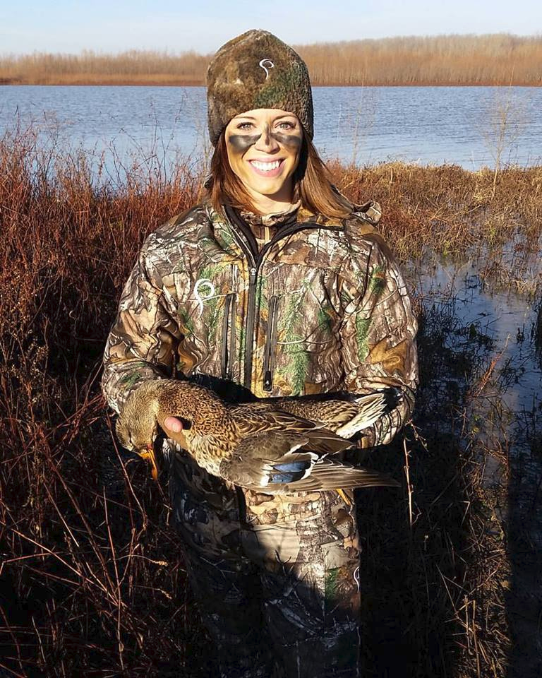
Target Market
People between ages 16-60 of both genders, who are avid bird or/and waterfowl hunters.
Aside from hunters would be bird researchers and others looking to expand knowledge about the bird species.

Slide 5
Differentiation
DeecDRONE can used for multiple different uses all while saving money.
Hunters will use less decoys on the ground to assist them because of DeecDRONE’s high technology.
DeecDRONE will make for the best up-close experience matching similar behaviors the species portrays while in use.
DeecDRONE is the first of its kind it will be ahead on all advancements and the first in the market

Slide 6
Solution
Either swimming or about to land, nothing will compare to the fun, effective, new DeecDRONE.
Customers will have the chance to assemble custom home kits which are completely universal for all types of adventures.
Giving hunters a better chance to meet their limits.
Researchers can open new doors to discoveries.
Youth can admire more wildlife.

Slide 7
Channels

Slide 8
Financials

Slide 9
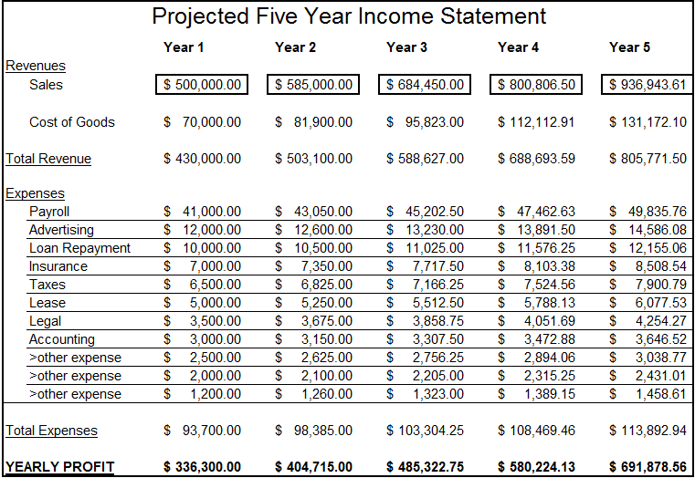
Financials

Slide 10
Conclusion
DeecDRONE has a projected revenue of $500,000 in its first year, creating many jobs.
An app will be made to share videos from all types of experiences linked to each DeecDRONE.

